Slide 1
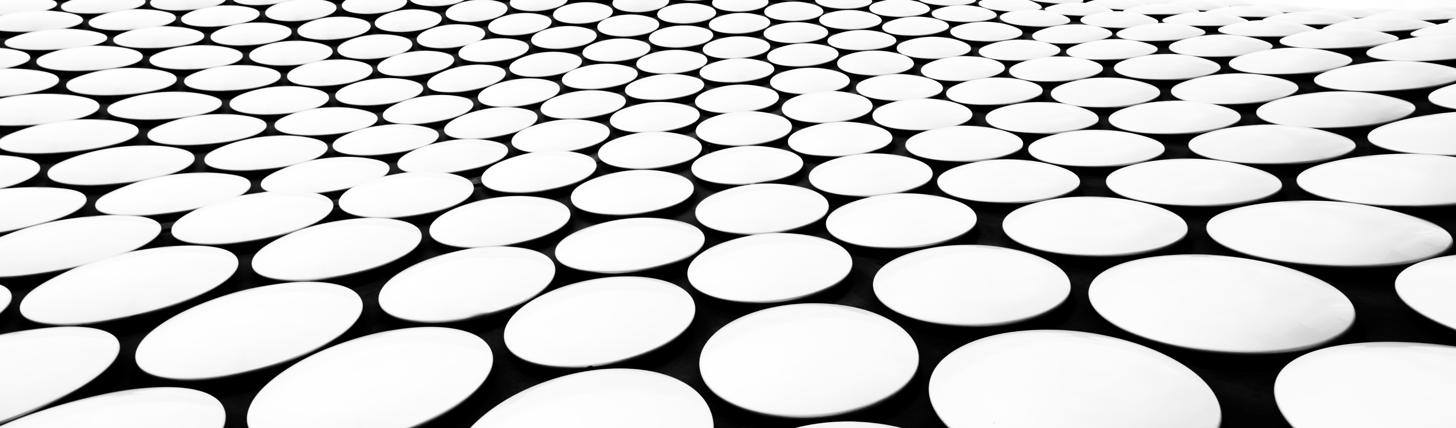
Image reconstruction
Autoencoders , DDPM , Diffusion Autoencoder , semantic Resnet Autoencoder

Slide 2
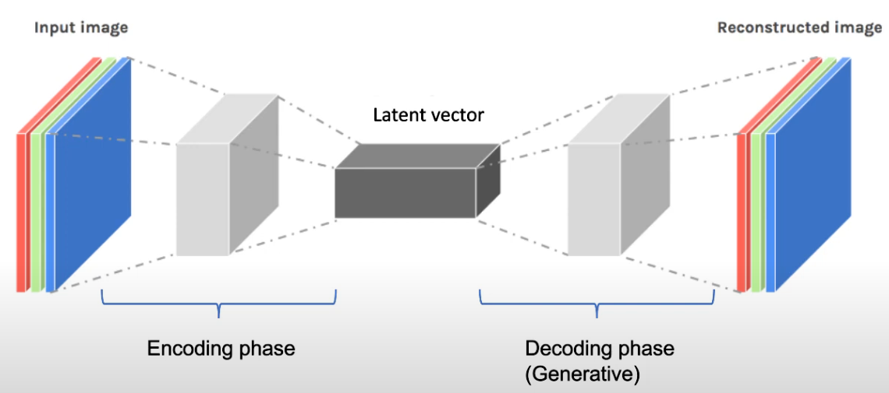
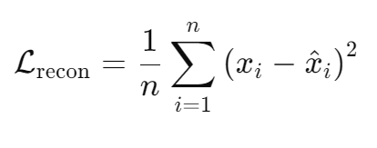
Reconstruction using an autoencoder
Focuses on minimising Reconstruction loss
n : No. of pixels or elements in the image
Xi : original ith pixel
Xi^ : reconstructed ith pixel
Lrecon : Reconstruction loss or MSE
Notes:
Noise reduction : The autoencoder is trained to filter out noise from the image. A clean image is destroyed by adding noise , and fed as the input . Training is done in a way where these noisy input images are mapped with the clean versions of the image which now act as the target(output). We reduce the loss function (MSE) for every epoch , where the encoder tries to extract features like edges , shapes which are unaffected by noise and create a latent space representation without the noise , and the decoder reconstructs it back to the clean image.

Slide 3
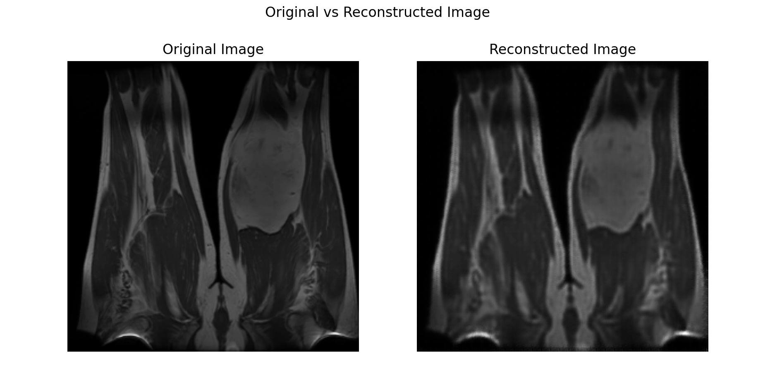
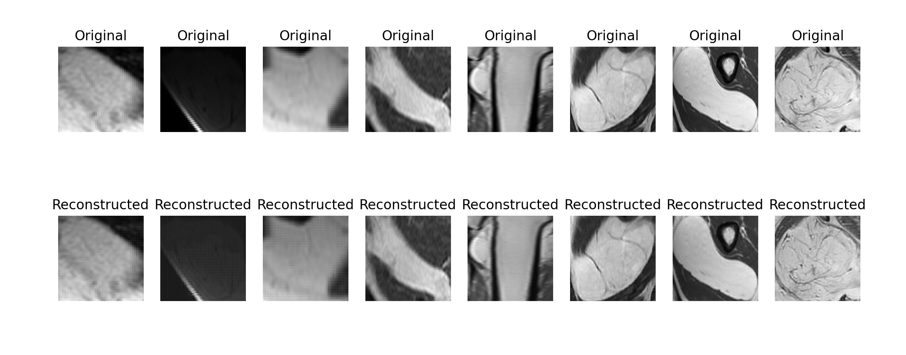
Autoencoder results
Autoencoders don't have structured or regularized latent spaces, making manipulation unpredictable.
Autoencoders only care about minimizing the reconstruction loss, which is why the encoder-decoder pair focuses solely on learning how to encode and reconstruct individual images. There’s no regularization that enforces the latent space to have specific properties, such as smoothness, continuity, or meaningful axes.
Lack of disentanglement of features

Slide 4
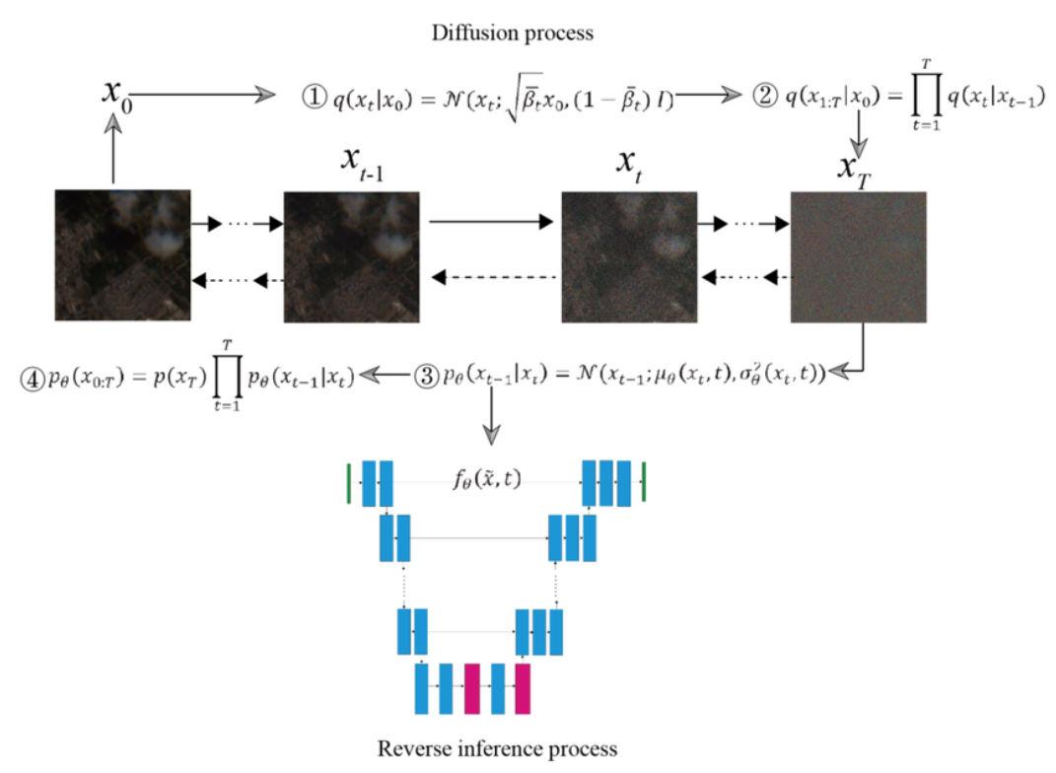
Generative models (ddpm – denoising diffusion probabilistic models)
Notes:
The forward diffusion process is a Markov chain , where the output at time t is dependent on the output at out t-1. We use a noise scheduler , where we use beta as the parameter of variance and we gradually keep adding noise to the clean image at every step till time t. The value of B is between 0,1 so that we do not get incredibly large values. The reason we do a forward diffusion is because we want to convert the image which is a complex distribution with all the patterns , into a simple normal distribution which it ends up to be the noise. The reverse diffusion process completely focuses on using a Unet architecture where we feed in the noisy image from a particular time step t and we try to predict the noise that has been added to it. The reverse process is parametrized by a neural network where we try to sample the image at xt-1 from xt by predicting the mean and variance. The unet captures the high level features of the image and there are attention blocks that are responsible for capturing the lower level features as well within the noisy data. The predicted noise from time step t is subtracted from the image of time step t and is fed into time step t-1. The entire unet works on minimising the MSE loss as well between the true noise and the predicted noise. So how do texts come into the picture?
In a standard unet during reverse diffusion process while sampling xt-1 from xt by predicting the mean and variance , we also take into consideration text. The texts are converted into their semantic representation and they are either concatenated into the noise or the unet has cross attention blocks that takes in context from the semantic representations of the text prompts as well. Now we have that the predicted noise will have more influence of the text prompt and once subtracted from the base image , it will eventually create new data.

Slide 5
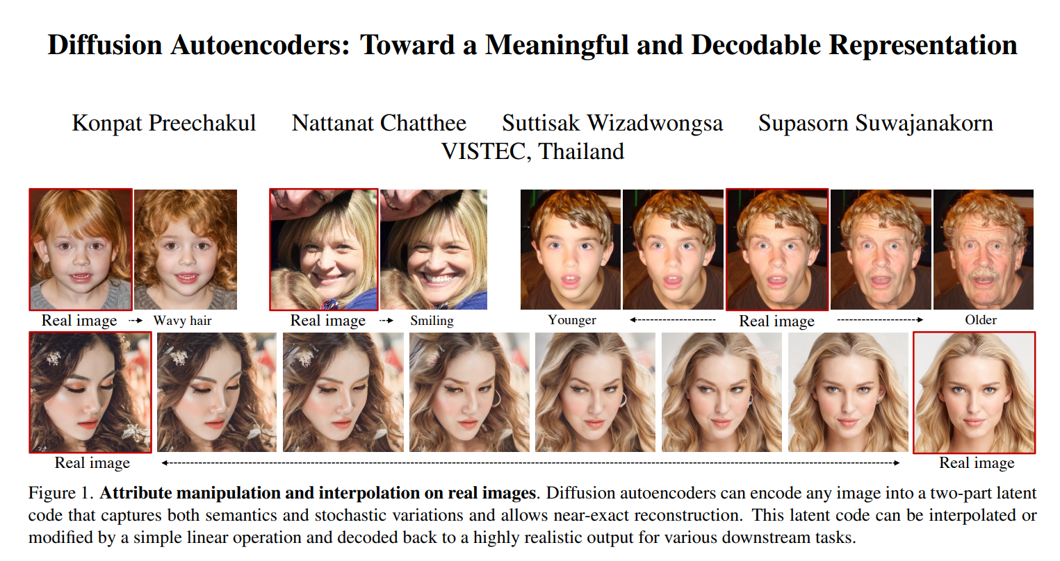
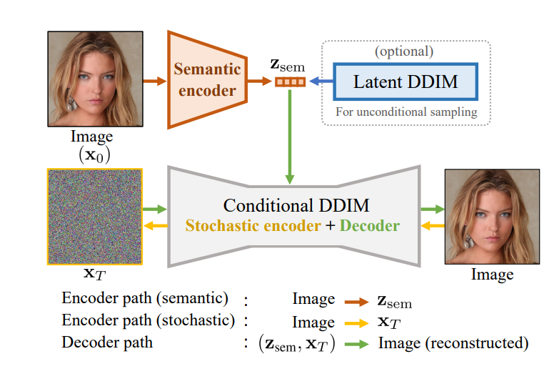
Diffusion autoencoders (DAE)
Notes:
A semantic encoder is basically involved in converting images / texts / audios into their numerical representations or vectors. We do it by passing an image through layers of ANN (Fully connected) , or transformers., or even ResNets , and updating the weights accordingly through backpropagation. This neural networks ensures that the weight values are multiplied with the pixel values of the image at every step and the loss function is updated . This method ensures all the important features like shapes , color textures are learnt and ultimately we are left with a one dimensional array called an embedding that can then further be used for generation.
So in context of the text prompts in the previous step , daes implement a semantic encoder on the clean image to extract their features and just like texts are converted into their respective embeddings by transformers , here a resnet18 architecture is used to extract important features from the image and convert in into it’s latent representation . The DDIM model is then fed the latent distribution’s informations while the reverse diffusion process , ensuring the latent space can be manipulated later on to make changes to the image.

Slide 6
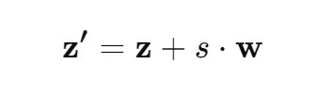
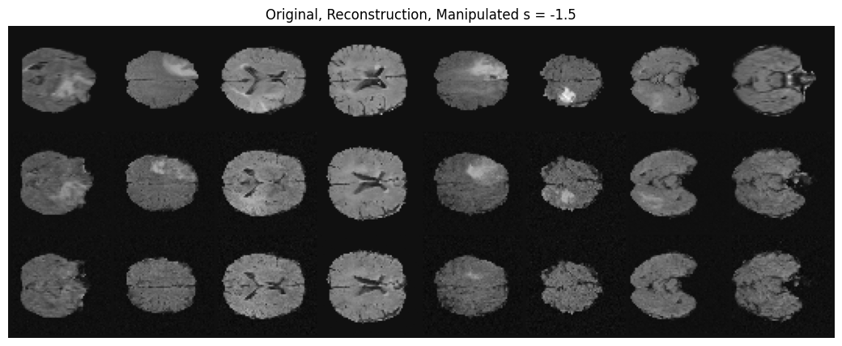
Dae results (brats)
z’ = Manipulated latent vector
z = original latent vector
s = degree of manipulation
w = weight vector learnt by the logistic regressor
Notes:
The first results we obtained was from a BRATs dataset which incorporated a MONAI Diffusion Autoencoder (A MONAI unet with attention blocks with a semantic resnet18 architecture) , a DDIM noise scheduler kept adding noise to the original image , and parallely a resnet 18 encoder extracted the important features and stored the data in a latent vector representation. The latent vector representation information was concatenated with the noisy image during the reverse diffusion process and the image was reconstructed back with the latent representations being the true witness to the transition. This latent representation was then fed into a logistic regressor focused on classification which learned the direction of change for w and that was used to change the beings into malignants and so on. (confirm tomorrow)

Slide 7
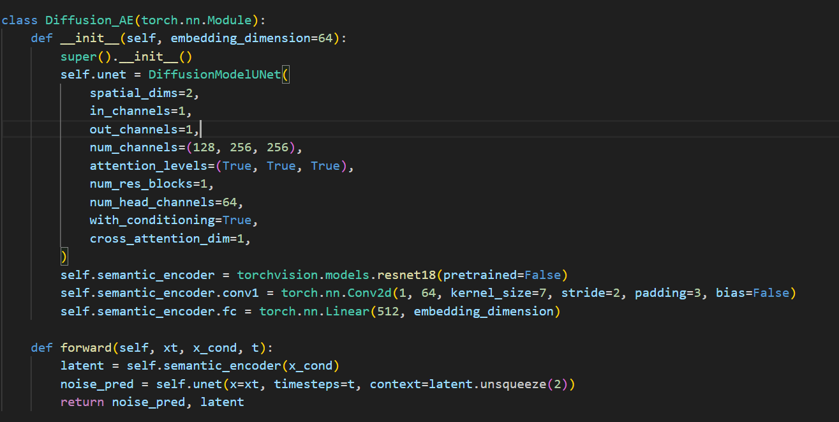
CURRENT WORK DAE FOR LIPOMA

Slide 8
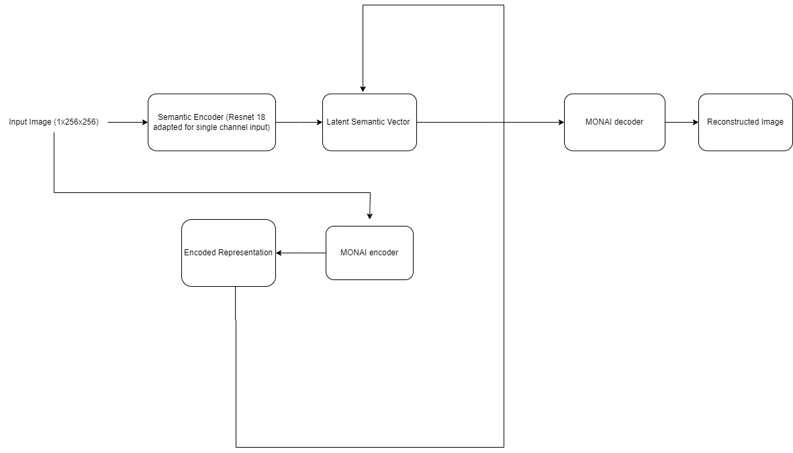
CURRENT WORK Proposed architecture for reconstruction and manipulation (semantic ResNet autoencoder)

